Slide 1
Project RARA
(Recruit Among Resumes Automatically)

Slide 2
Team Members
Anand Kumar, 3rd year Computer Engineering student
Kamboji Akhilesh, 3rd year Information Science student
Mamtha S, 3rd year Information Science student
Darshini R, 3rd year Information Science student

Slide 3
Overview
Companies and Organizations have huge number of job seekers with huge number of Resumes and they can select only few candidate’s Resume.
Manually going through all the Resumes will take a huge about of time and hand work.
An algorithm which can automatically identify the expertise of candidates in any field from All Resumes in Once will be very helpful as manual work will be removed and also a lot of time can be saved with great accuracy

Slide 4
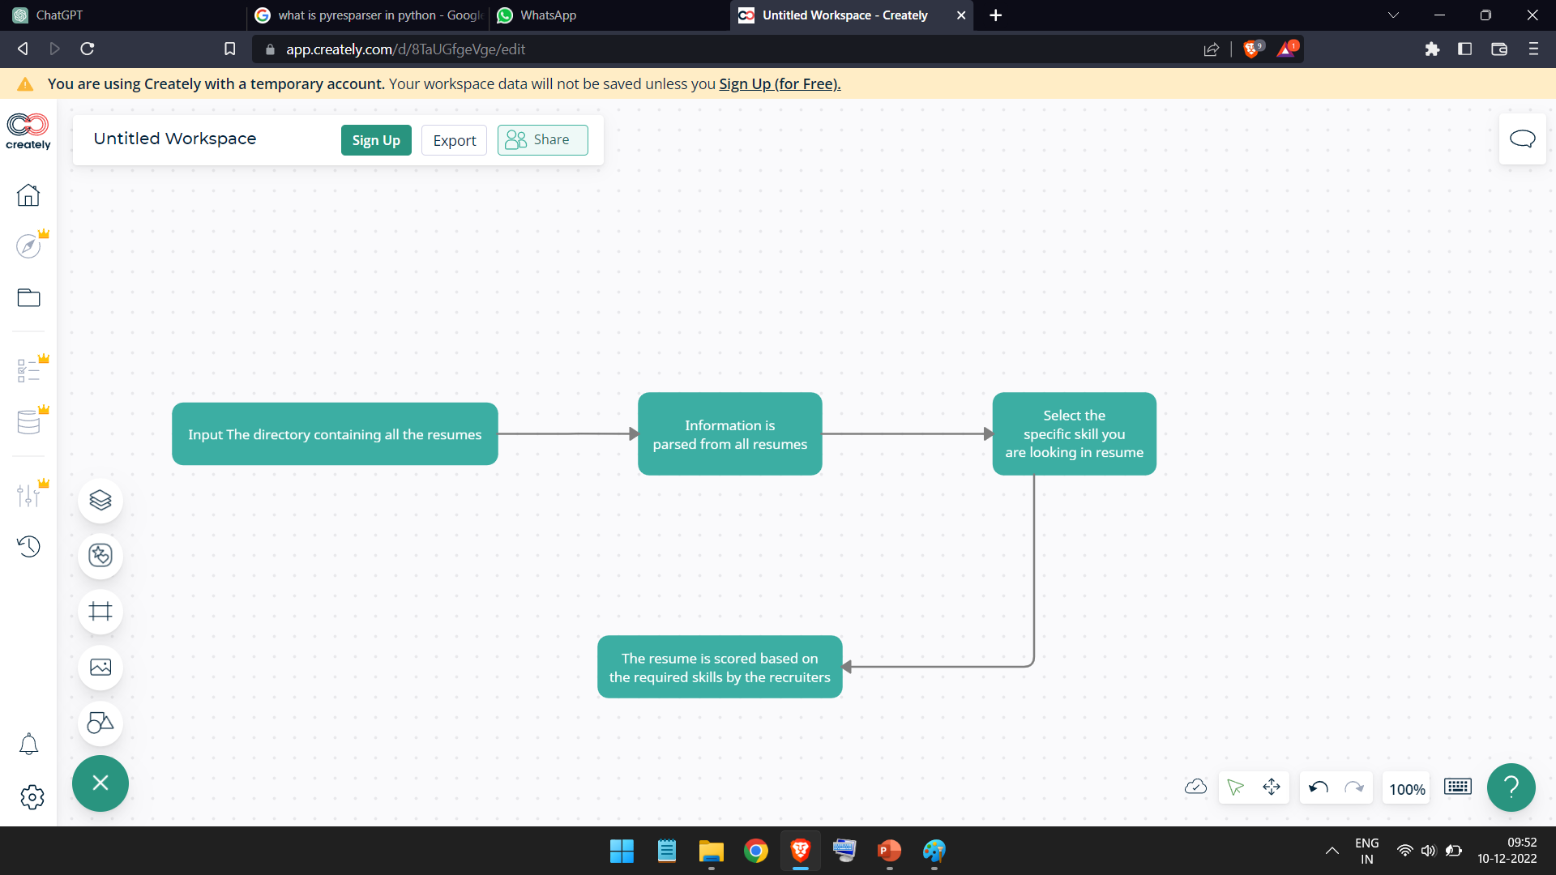
Block Diagram

Slide 5
Working
All the resumes of pdf docx, txt etc. format located in the specific folder will be scanned altogether.
The following data from each resume will be parsed:-
Name
Email
Mobile Number
List of all skills
College name and degree
Experience (Every company candidate has worked will be considered)
Experience (Number of years)

Slide 6
Continued…
Now the job seeker can select the specific skill he is searching for from all the skillset.
After it, resume will be scored automatically taking the following details in account :-
Experience (no. of years, quantitative)
Skillset
Type of experience (qualitative)

Slide 7
Libraries Used and roles
SPACY
Tokenization: spacy can split a string of text into individual tokens (e.g. words, punctuation marks, etc.)
Part-of-speech tagging: spacy can automatically assign a part-of-speech tag to each token in a sentence (e.g. noun, verb, adjective, etc.)
Named entity recognition: spacy can identify named entities in a sentence (e.g. people, organizations, locations, etc.) and label them using the BILUO scheme.
Dependency parsing: spacy can analyze the grammatical structure of a sentence and identify the dependencies between individual tokens.
Sentence segmentation: spacy can segment a document into individual sentences.

Slide 8
2. OS
The os library in Python provides functions for interacting with the operating system. This can include reading and writing files, working with the file system, and launching external programs.
In general, the os library is a useful tool for working with the file system and launching external programs in Python. It can be particularly helpful for automating tasks such as file management and data preprocessing.

Slide 9
3. Pyresparser
A simple resume parser used for extracting information from resumes.
4. Pymongo
Pymongo is a powerful and convenient library for working with MongoDB databases in Python.
It allows easy interaction with data, perform complex queries, and handle common tasks such as data validation and index management.

Slide 10
Advantages
This Ai recruitment tool will make hiring process easier for both hiring teams and job seekers
Time saving
Infinite use
Accuracy
If would take around 5 hours to go through 100 resumes manually, using this tool the same task can be done in few minutes and save a lot of time.

Slide 11
Scope of the project
In future updates, following criteria can be added for Selecting Suitable Resume
Lets consider an example where we are looking for candidate good in java programming language. Then following criteria’s would be examined :-
Contributions to java community :- Candidate who has contributions to java community such as open source projects, writing blogs and articles, or given speech about java in conferences.
Skills in relevant field :- Candidate with knowledge in field related to java field such as Object Oriented Programming, Data Structures.
Education :- A candidate having educational degree related to java programming will have better chance in being selected as a desired candidate.

Slide 12
Continued…
5. Personal projects :- Candidate who has built useful and interesting projects out of his own interests using java, which have been uploaded in websites like GitHub, maybe considered as a candidate good in java.
6. Location :- Candidate whose residence is near the office will have minor more preference in case the work does not support remote job
7. Problem Solving Ability :- A person with good problem solving ability related to coding, especially in java example :- Debugging, optimizing the code.

Slide 13
THANK YOU

